Slide 1

Slide 1
IoT ANALYTICS
Power Management
By Steven Melendez

Slide 2
Agenda
Internet of Things (IoT)
Sub-Metering & Power Management
Background
Goals / Objectives
Data Management
Exploratory Data Analysis
High Level Recommendations
Next Steps
1

Slide 3


Internet of Things (IoT)
The internet of things, or IoT, is a system of interrelated computing devices, mechanical and digital machines, objects, animals or people that are provided with unique identifiers (UIDs) and the ability to transfer data over a network without requiring human-to-human or human-to-computer interaction
2

Slide 4

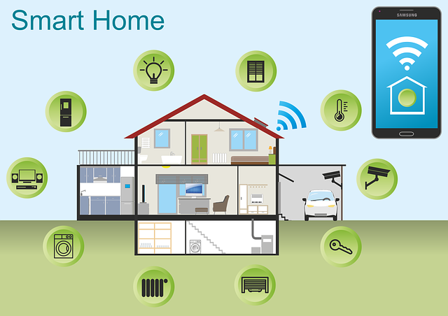

Sub-metering & Power Management
Utility sub-metering is a system that allows the landlord or the property management firm bill the tenants individually since the utility usage is also measured separately.
Utility sub-metering also requires monitoring of the consumption of the electricity of each piece of equipment within a building including the refrigerator, HVAC, outdoor/indoor lighting, kitchen equipment and more
3

Slide 5
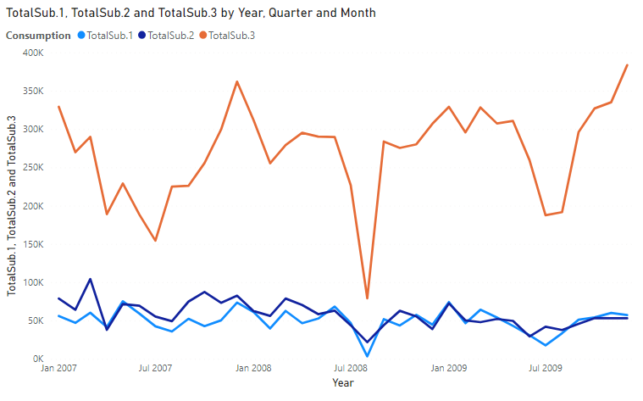




Background
Use of time series analysis to extract meaningful statistics and characteristics about the energy consumption data.
Time series Analysis helps us understand what are the underlying forces leading to a particular trend in the time series data points and helps us in forecasting and monitoring the data points by fitting appropriate models to it
4

Slide 6


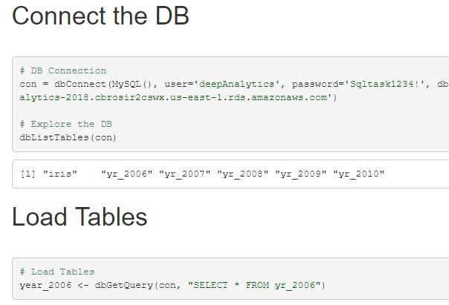



Slide 7
Goals and Objectives
Extract and organize the data
Conduct an exploratory data analysis
Prepare recommendations

Slide 7
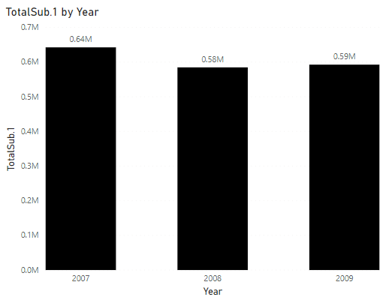
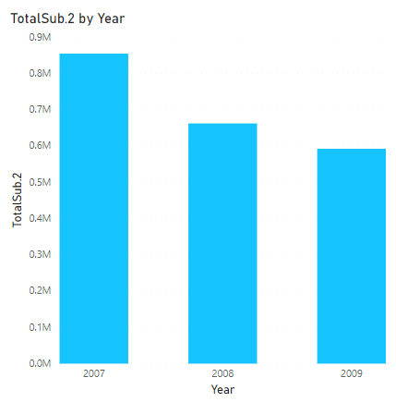
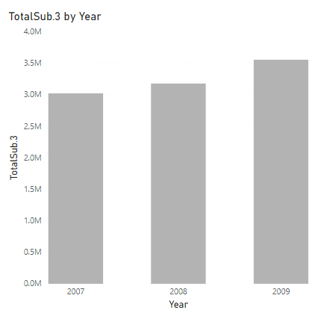
Slide 4
Exploratory Data Analysis
Sub
Metering 1
13%
Sub
Metering 2
15%
Sub
Metering 3.
71%
Kitchen, containing mainly a dishwasher, an oven and a microwave
Laundry room, containing a washing-machine, a tumble-drier, a refrigerator and a light
Electric water-heater and an air-conditioner
5

Slide 8
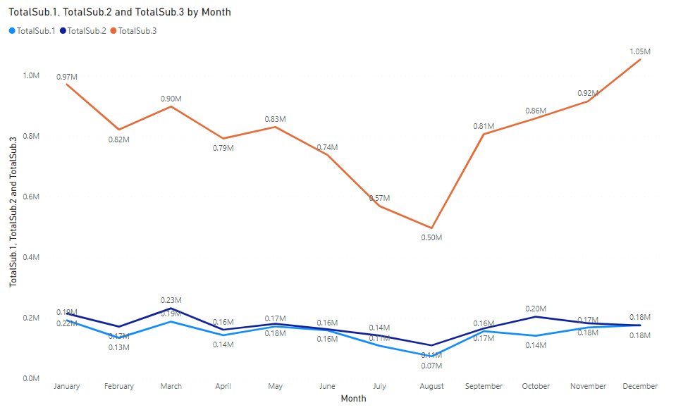
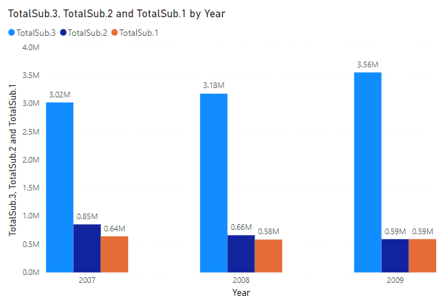
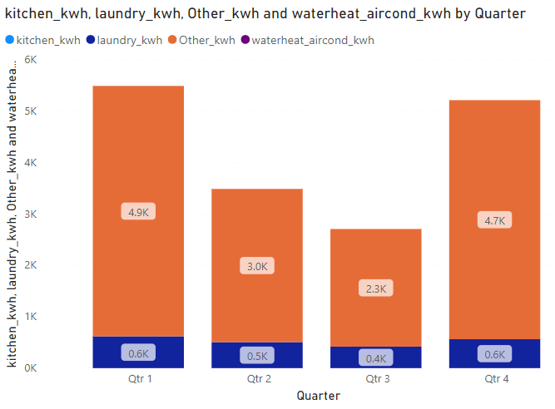
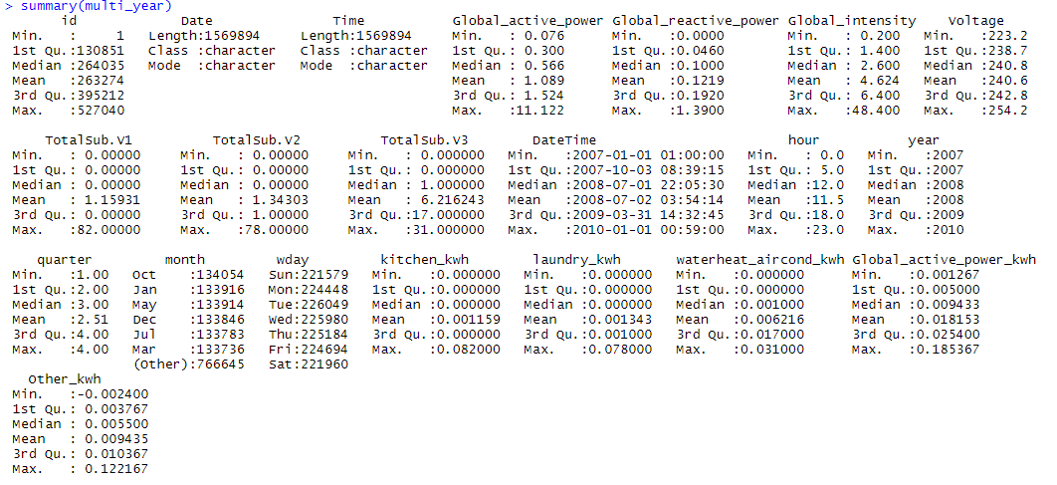
Exploratory Data Analysis

Slide 9
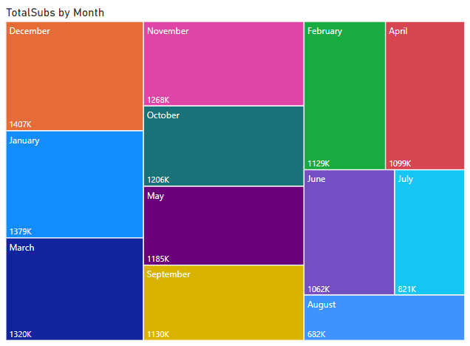
Slide 3
High Level Recommendations
FINANCING
MARKETING
Identify financial benefits of energy management
Identify market opportunities for IoT Analytics
OPPORTUNITIES
SCHEDULING
Identify additional opportunities for IoT Analytics
Define a project plan with the customer.
Your logo
3

